Slide 1
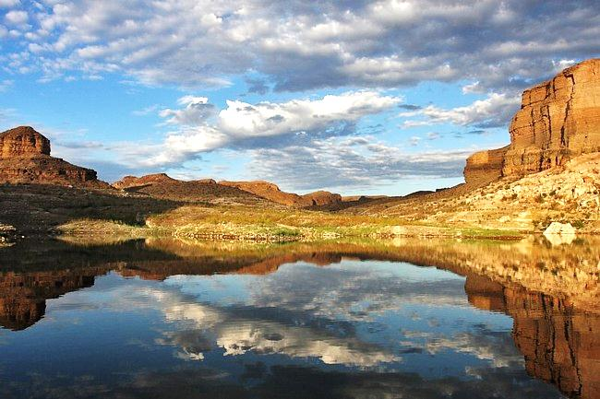

VISITING
LAKE MEAD NATIONAL RECREATION AREA
Notes:
The purpose of visiting the classroom before their field trip is so they can be better prepared for their upcoming visit. We want them to be excited about their field trip and help them voice any of their worries about the field trip. The things that you will need to bring with you to the school is the video, field notebooks, NPS patch logo, NPS brochure with all of the parks and any of the tools or instruments that they will be using on their field trip.

Slide 2
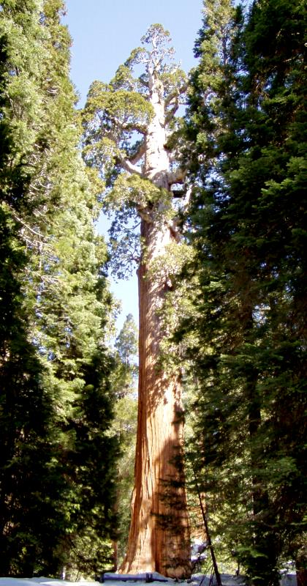

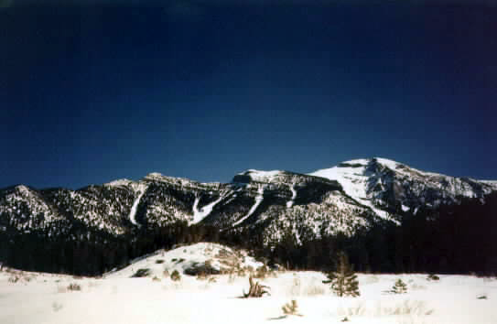
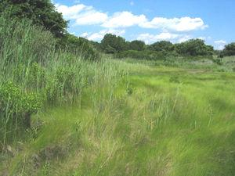
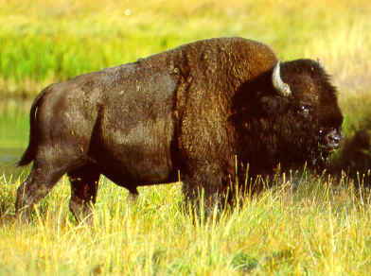
Notes:
They can find the arrowhead on a building or on a shirt of a Park Service Employee. Show them the picture of the arrowhead and ask them what they see on the page. All of the symbols on the patch represent something special about the different types of the parks. The arrowhead is a symbol of the cultural and the different cultural parks that are in America. The grass and the Sequoia tree represents vegetation in the parks. The mountain represents the beautiful scenery that is protected by the parks. The lake represents the water resources and the bison represents the wildlife resources protected by the National Park Service.

Slide 3
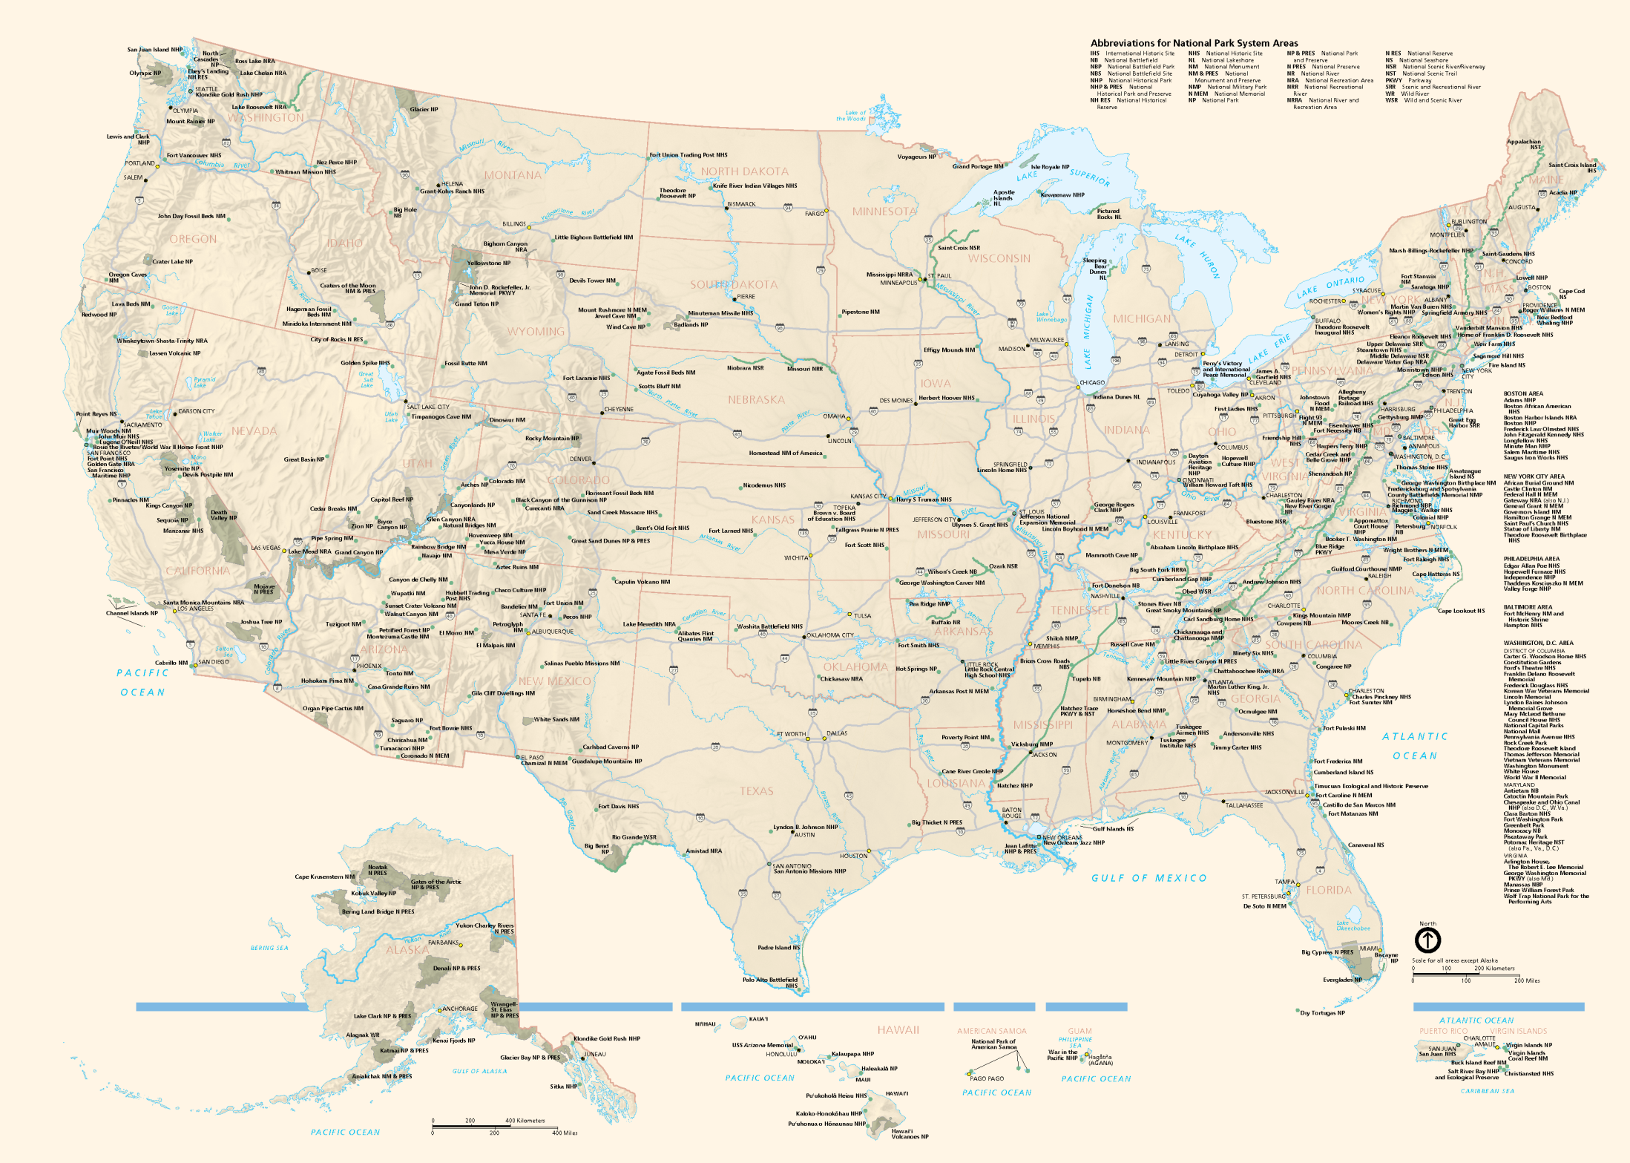
National Parks of the U.S.A.
Notes:
There are 412 National park sites in America and each of them holds a special meaning to the American people. A way to incorporate the idea of many different parks is to play a guessing game of couple parks. The three easiest parks to quiz the kids on is the Statue of Liberty, Martin Luther King Jr.’s boyhood home, and the Grand Canyon. You give the kids two or three clues about the park that you are trying to get them to guess and then explain what that park is unique or holds a special meaning to the American public. An ending idea to present to the kids that they are the proud owners of the National Parks areas so who’s responsibility is it to protect the sites?
(click on general area of park to access its picture)

Slide 4
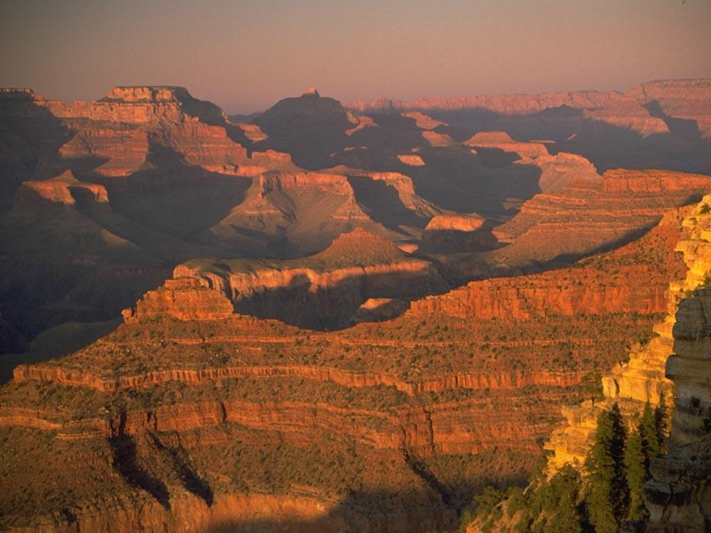
Grand Canyon
National Park
Notes:
Grand Canyon Nat’l Park

Slide 5
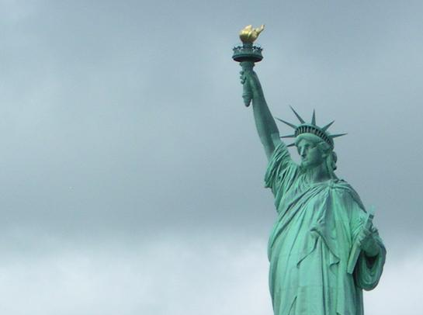
STATUE OF LIBERTY NATIONAL MONUMENT

Slide 6

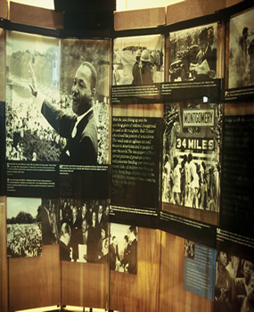
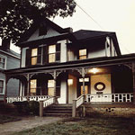
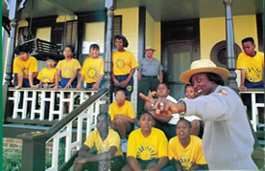
Martin Luther King, Jr.
National Historic Site
Notes:
The Birth Home of Dr. Martin Luther King, Jr., may be visited only with a park ranger led tour. The tours are filled on a first-come, first-served basis. Register for the tour at the National Park Service Visitor Center in person upon arrival to the park.
Martin Luther King’s House in Atlanta, GA.

Slide 7
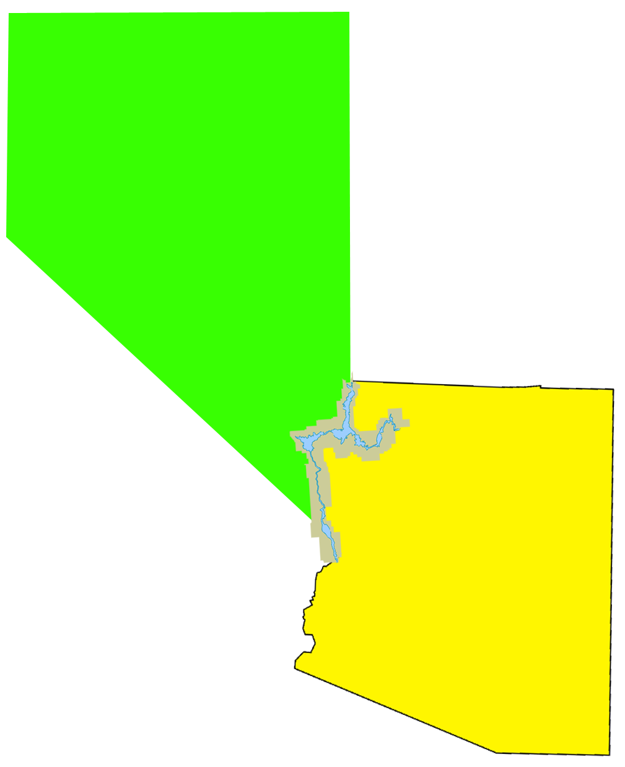
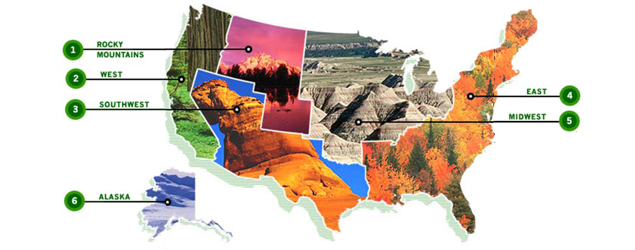

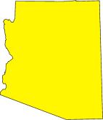
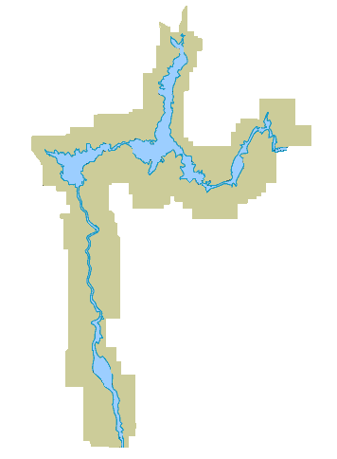
WHERE ARE THE NATIONAL PARKS?
Where is Lake Mead?
Lake Mead
Lake Mohave
Notes:
Explain the mission of the Park Service and we are here to protect and preserve the National Parks for everyone.

Slide 8
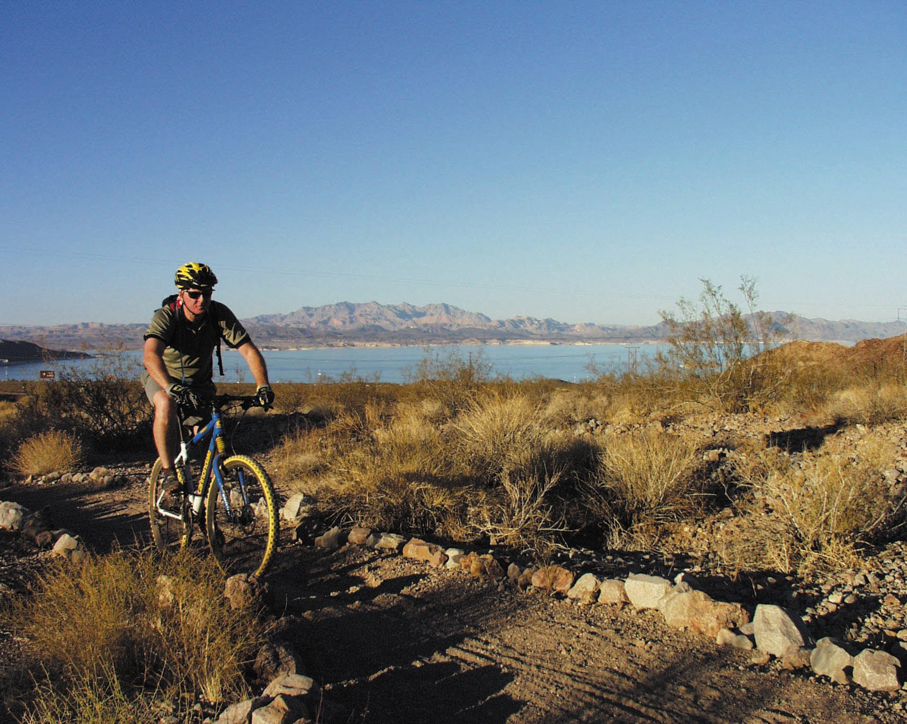
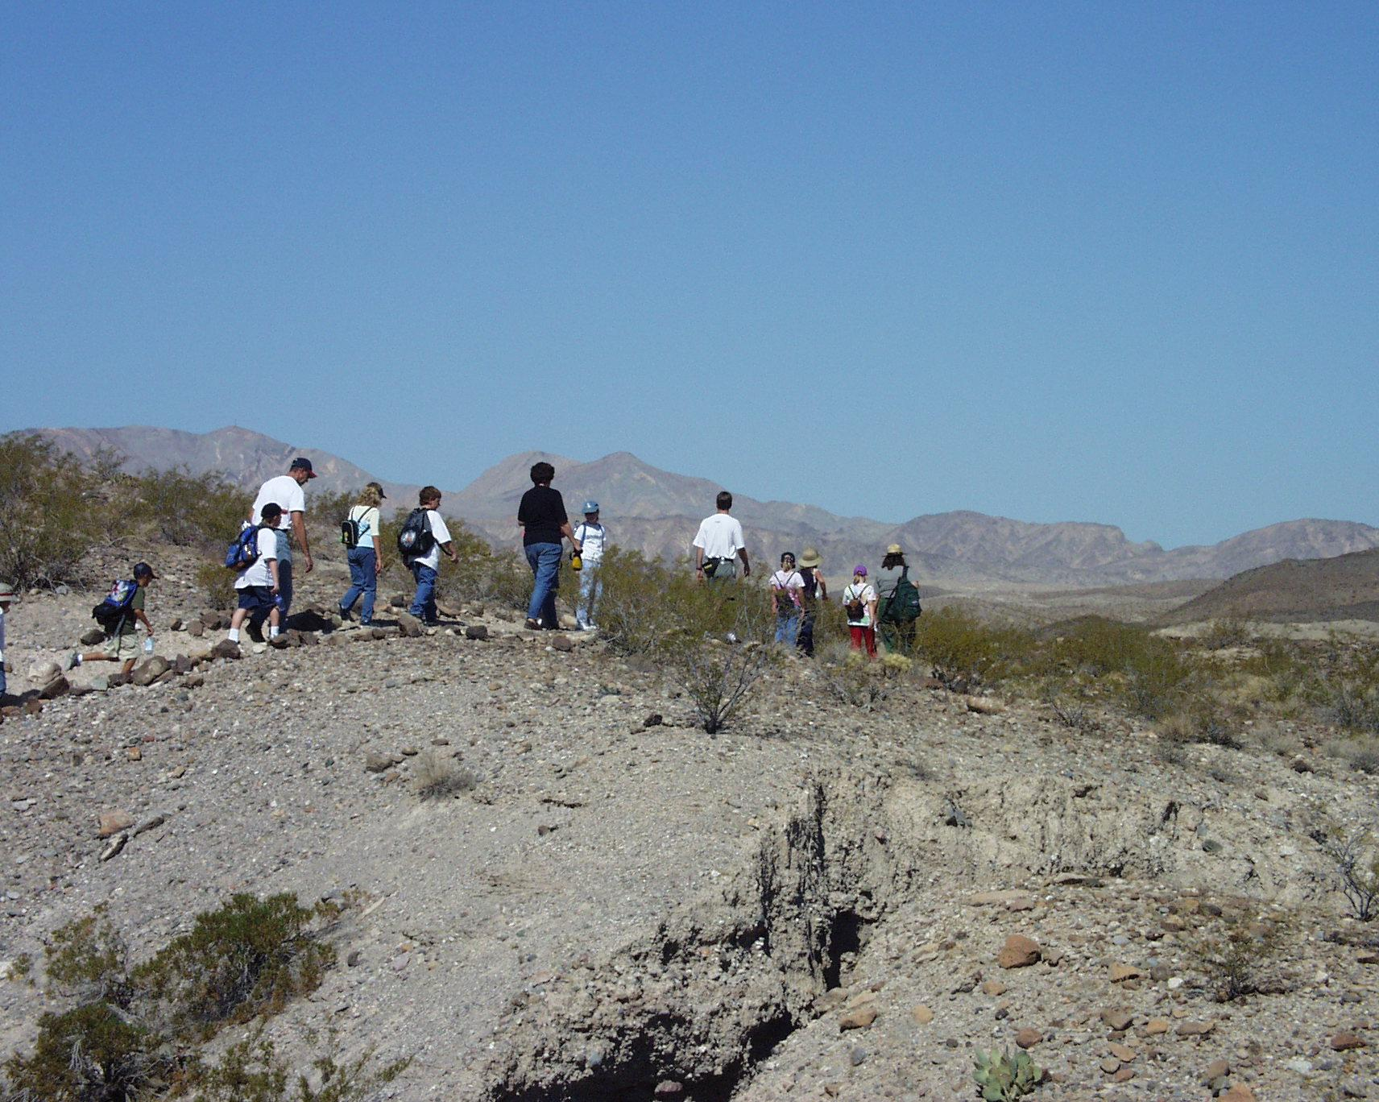
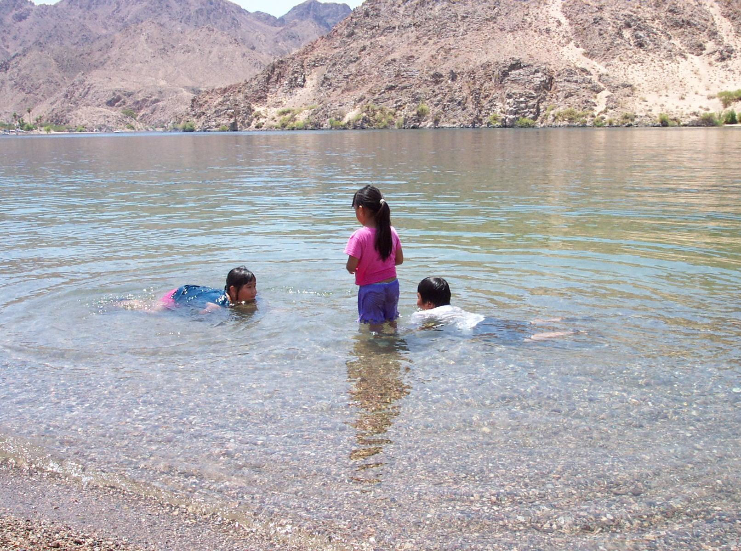
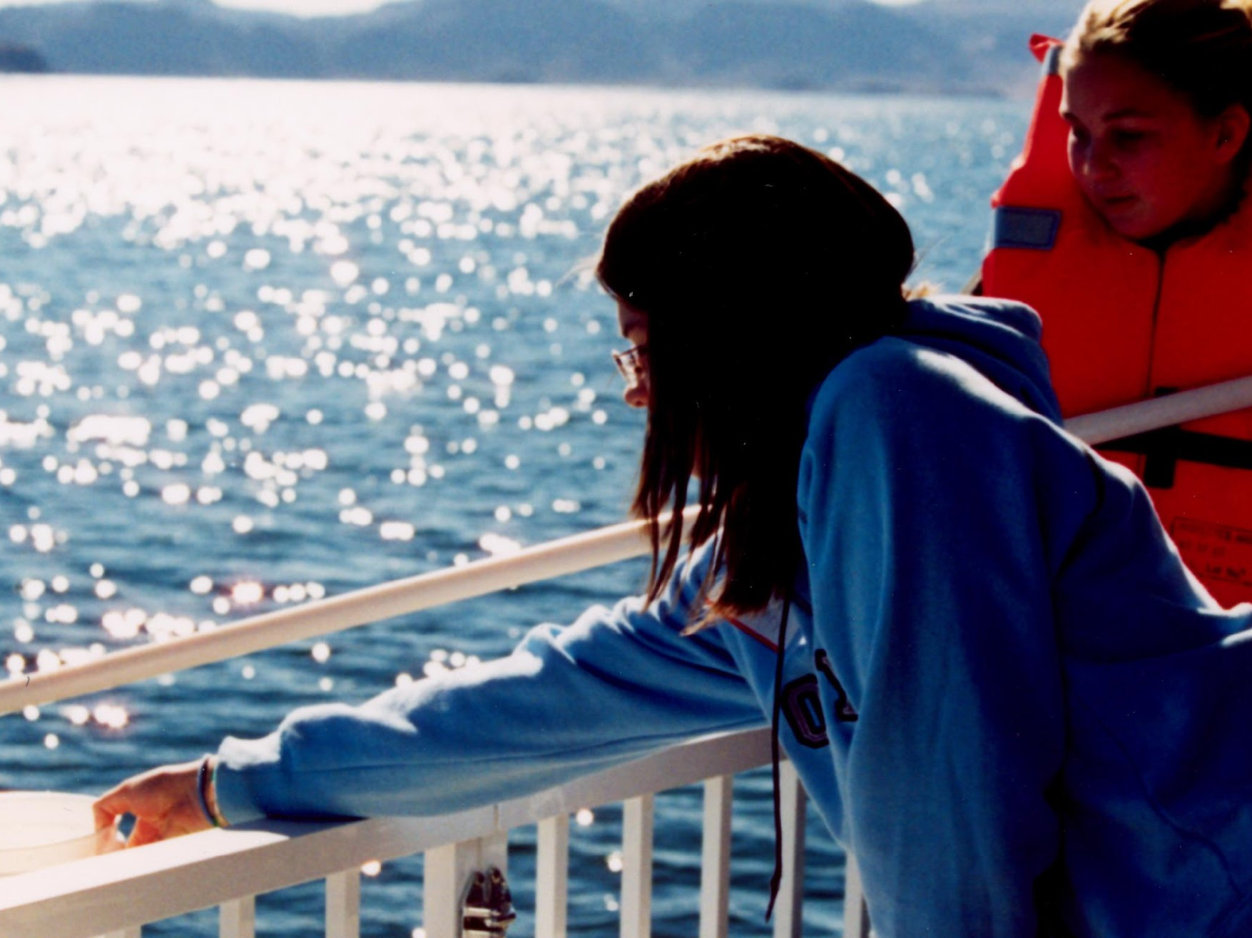
WHAT CAN YOU DO AT LAKE MEAD NRA?
Bike
Hike
Swim
Go out on a boat
Notes:
Start out by asking how many of the kids have been to Lake Mead before and what kinds of things they like to do while visiting

Slide 9
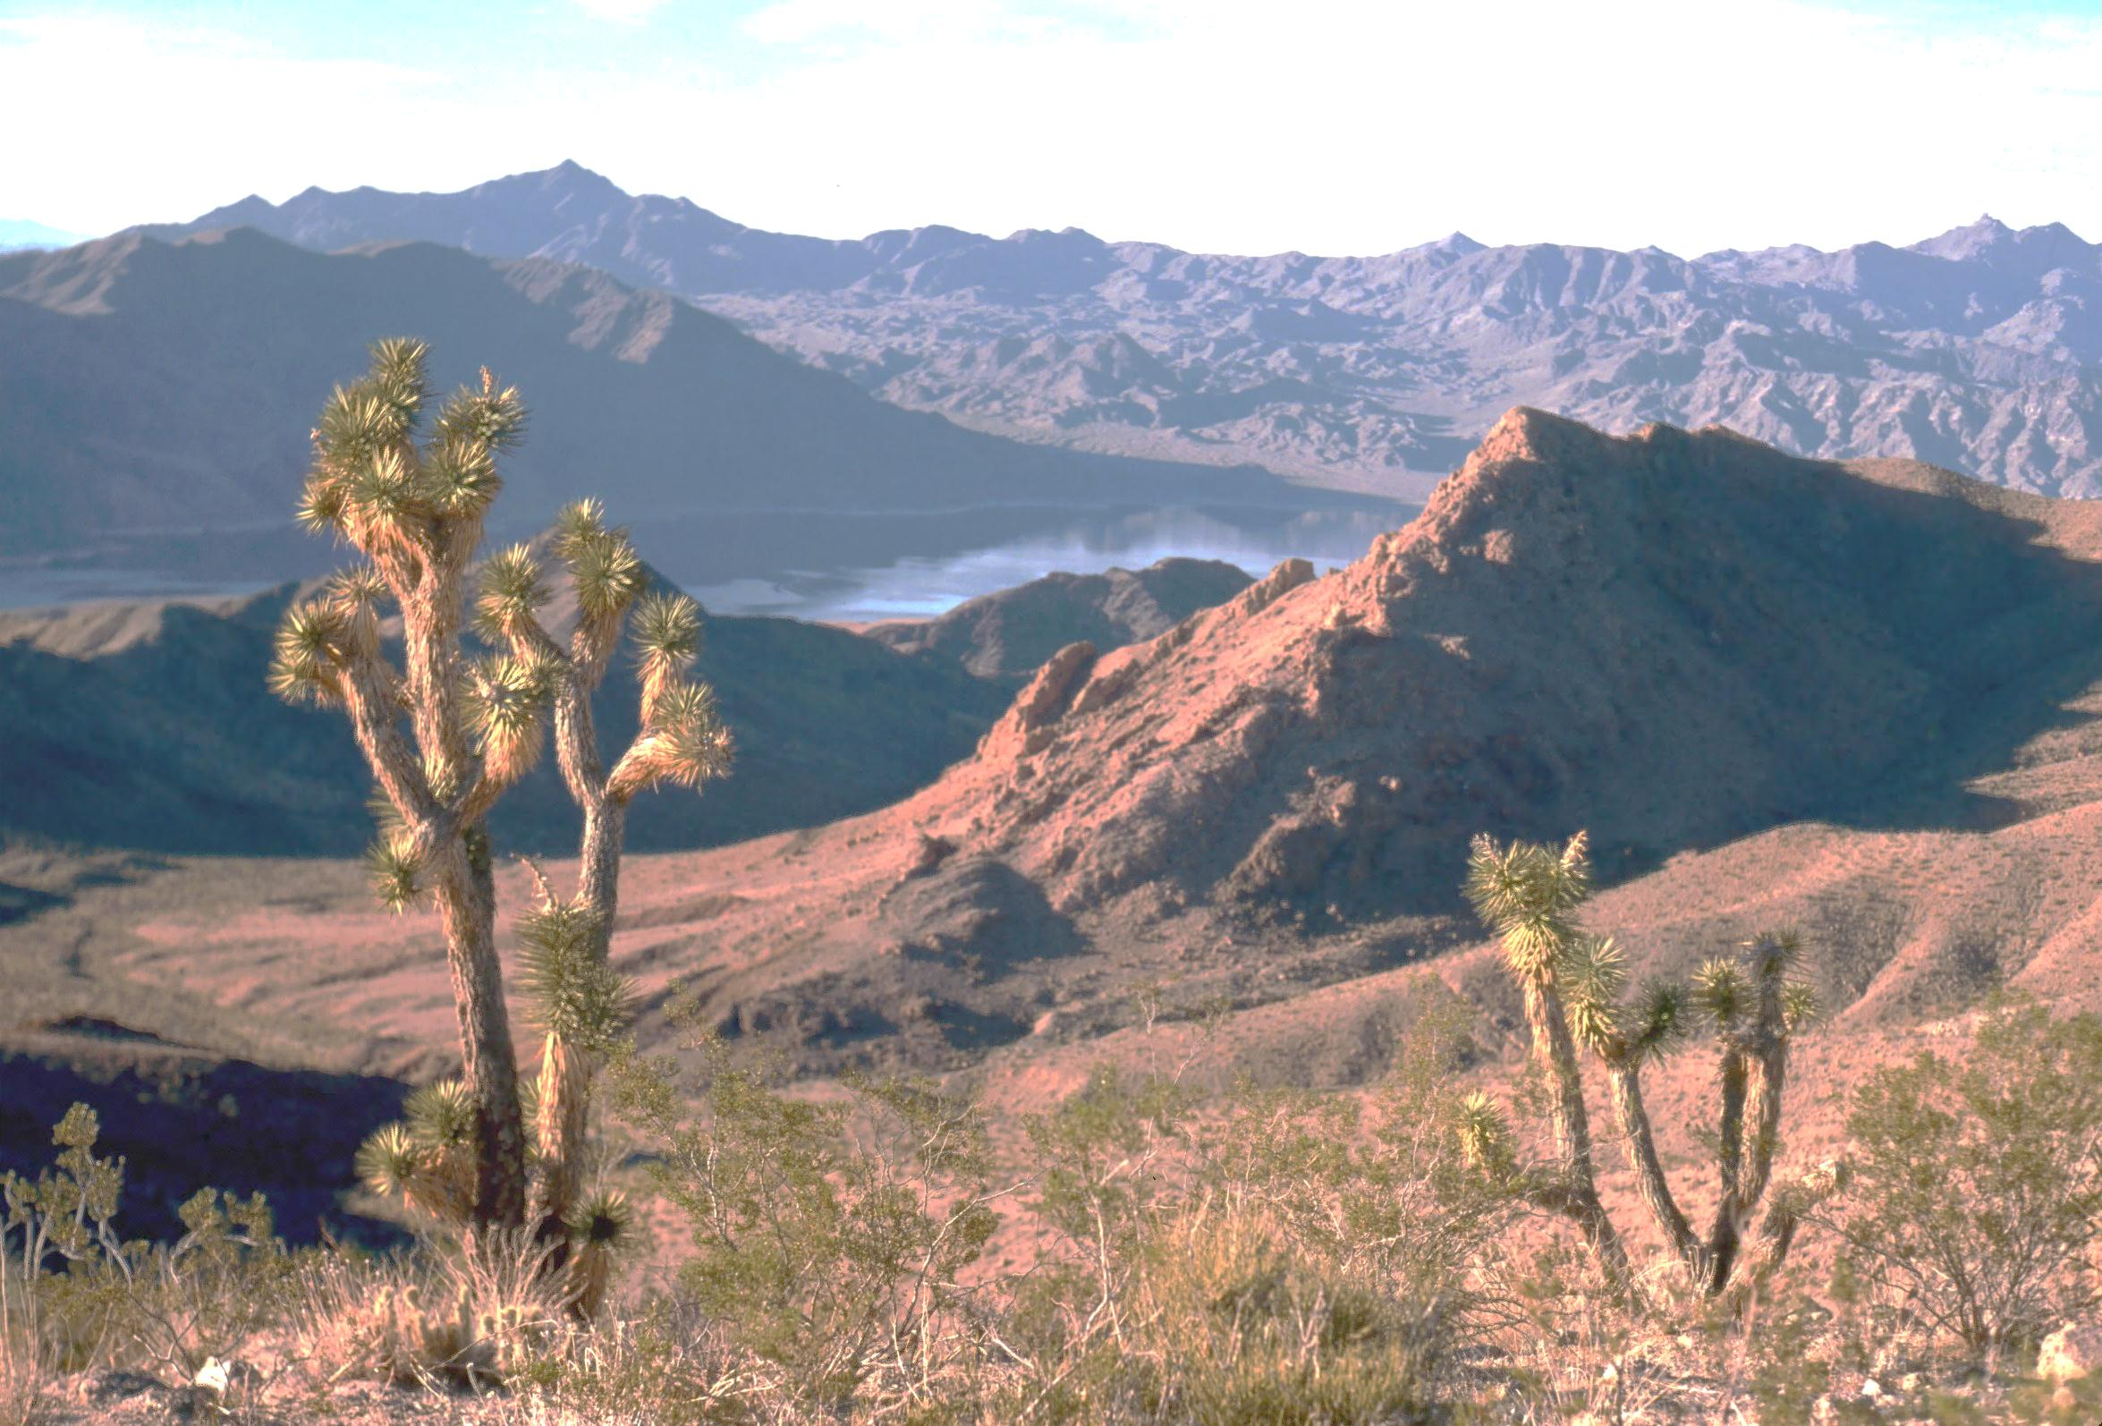

WHAT ARE WE GOING TO DO?
What are you going
to do on the field trip?
Notes:
Ask the students what they think they might see when they are on their fieldtrip. Let them know where they are going and what they will be visiting on their fieldtrip and what they are going to learn about. We expect them to give us their full attention on the filed trip, just like their teacher expects them to give him/her their attention in the classroom. Let them know that they are going to have fun, they are going to learn a lot, and they might get to see some animals. Remind them that even though they were many animals on the video, they might not get to see that many. When we shot that video, it was the perfect time of year and they might not see as many animals, but they will see lots of clues that animals live in the desert. This might lead into discussions of the fears that they might have about coming out for the field trip.

Slide 10
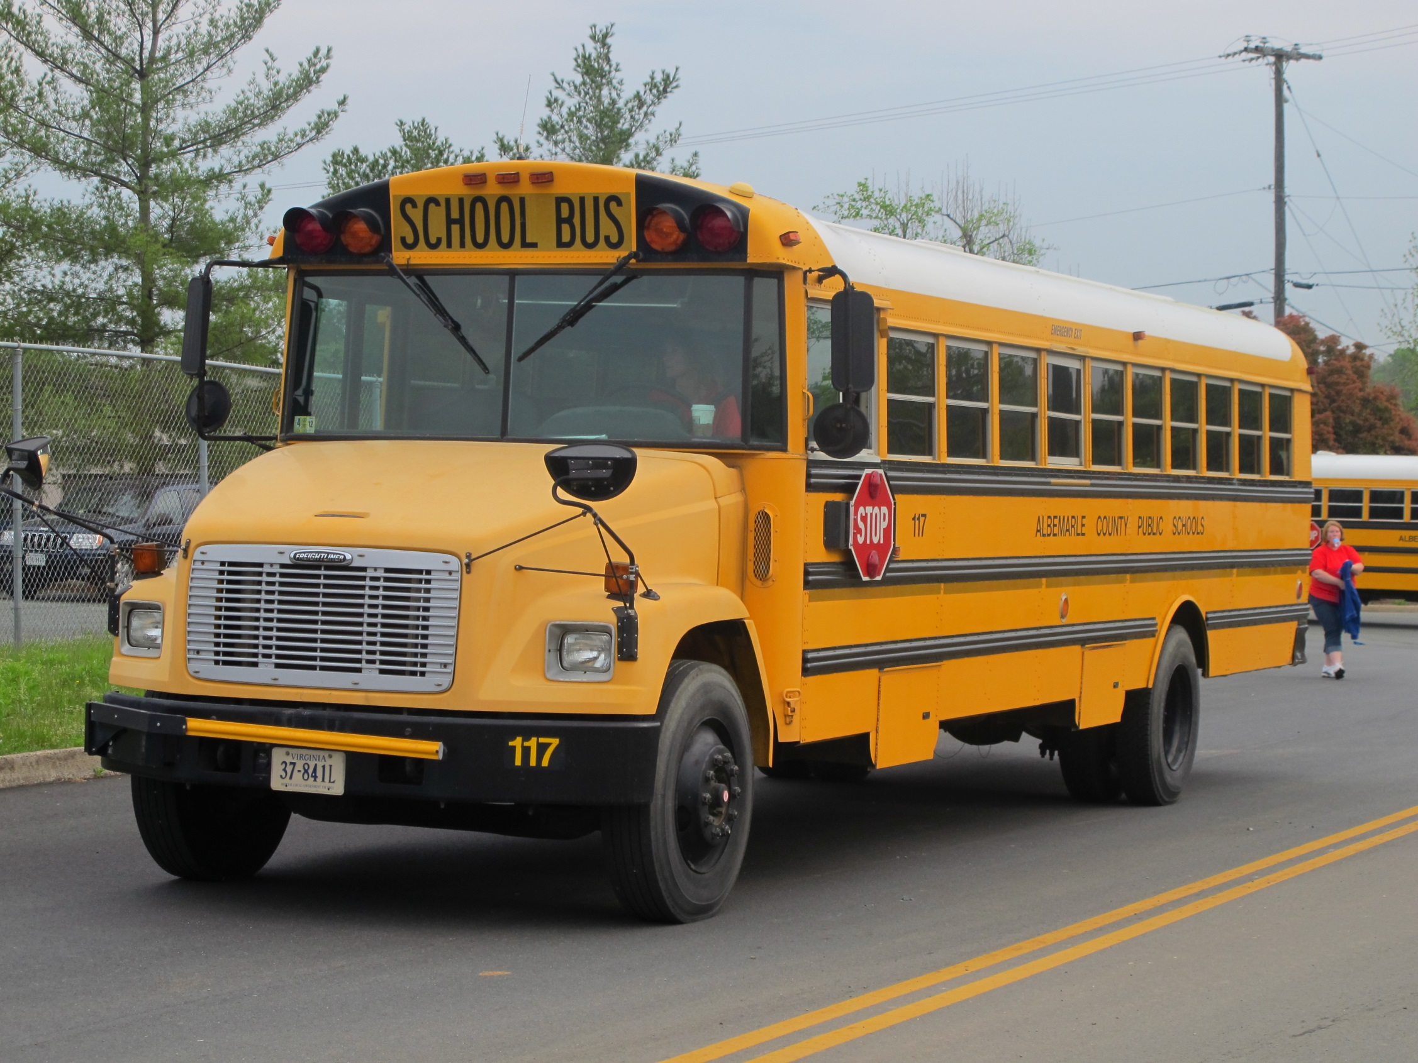

Slide 11
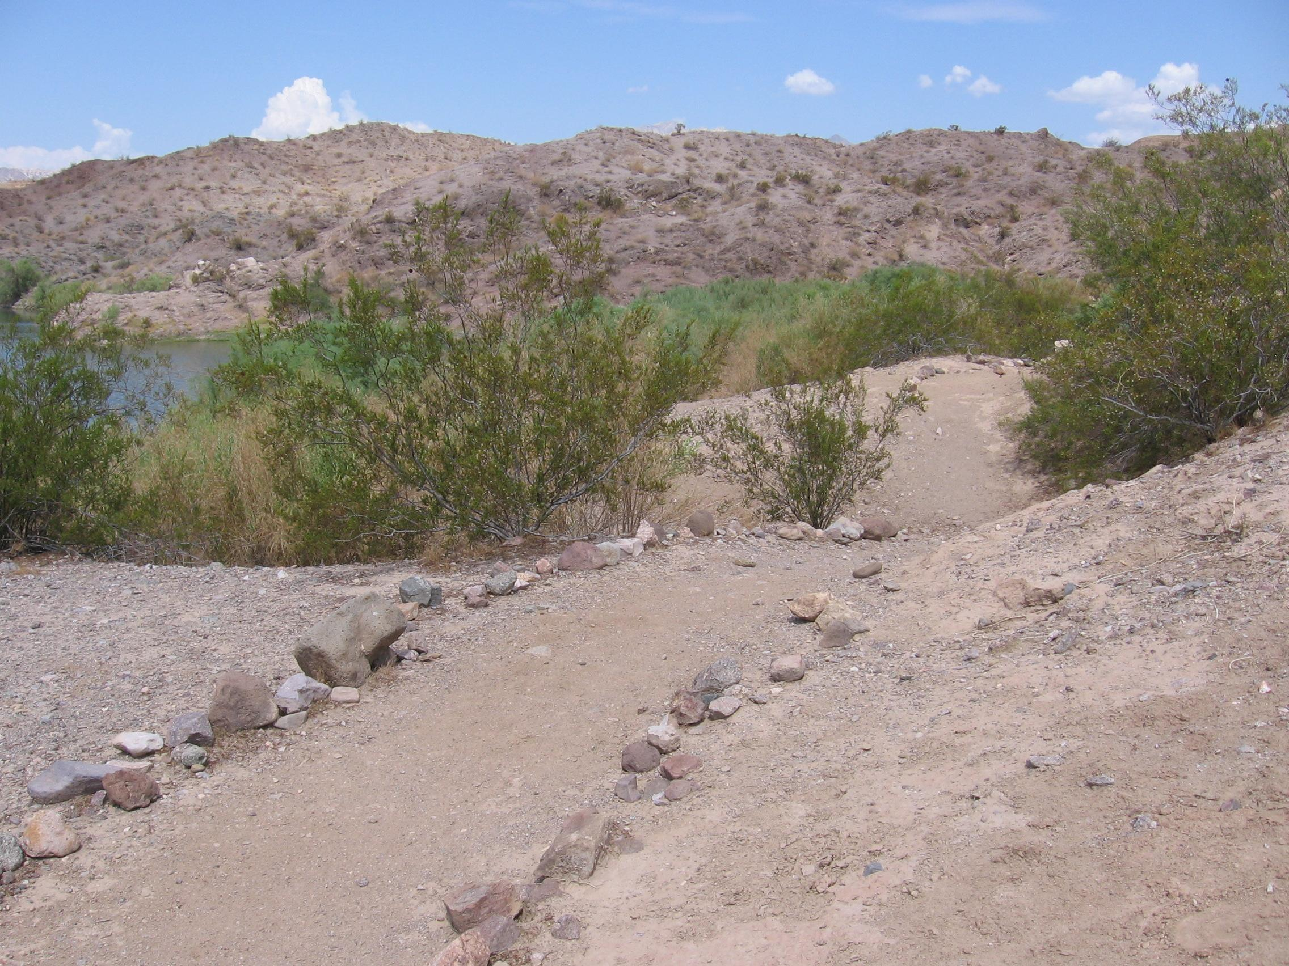

Slide 12
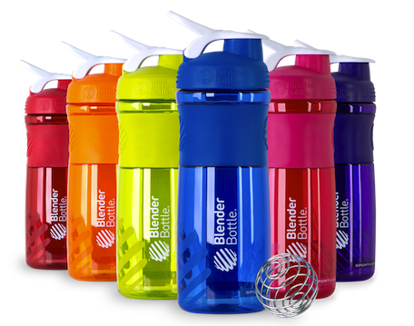
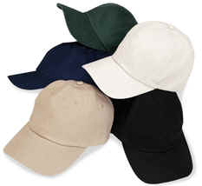
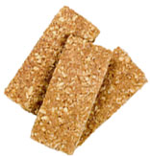

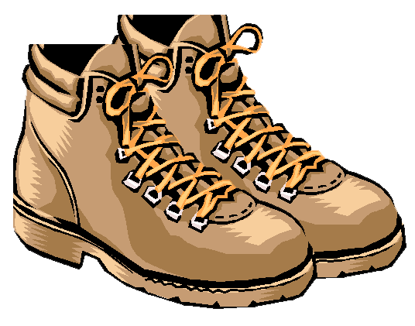
WHAT SHOULD I BRING?
Backpack, pencil, notebook
Water Bottle
Good walking shoes
Sunscreen
Snack
Hat
Notes:
Ask the kids what kinds of rules their teacher has while they are in the classroom or out on the playground. The rules that they might mention would be to keep their hands and feet to themselves, not to talk when the teacher is talking, no running and to be nice to their classmates. Tell them that we have rules too, and it’s because we want them to be safe when they come visit us. Let them know that they are to stay with their adult chaperone at all times.
What should I bring?
A snack that will not melt
A water bottle – separate from your lunch. No glass containers
A backpack to hold your water bottle, snack and field journals that you will be getting
What should I wear? Wear long pants and short sleeve shirts. On cooler days bring a lightweight jacket or sweatshirt and on a cold day bring a heavier coat.
Bring a raincoat or raingear if a rainy day is predicted.
Wear shoes for hiking on rough ground (no sandals)
Wear sunscreen on face and arms
Wear a warm hat for cold weather or a hat with a brim in for sunny days – the hat is your only shade

Slide 13
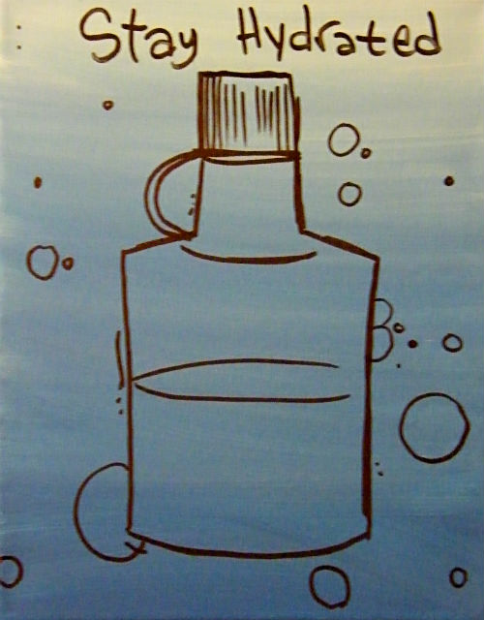
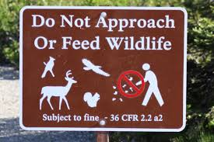

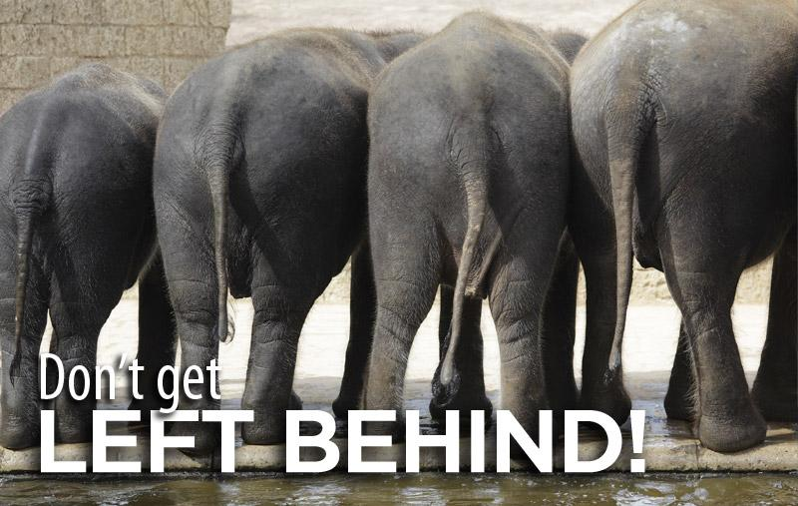
Safety

Slide 14
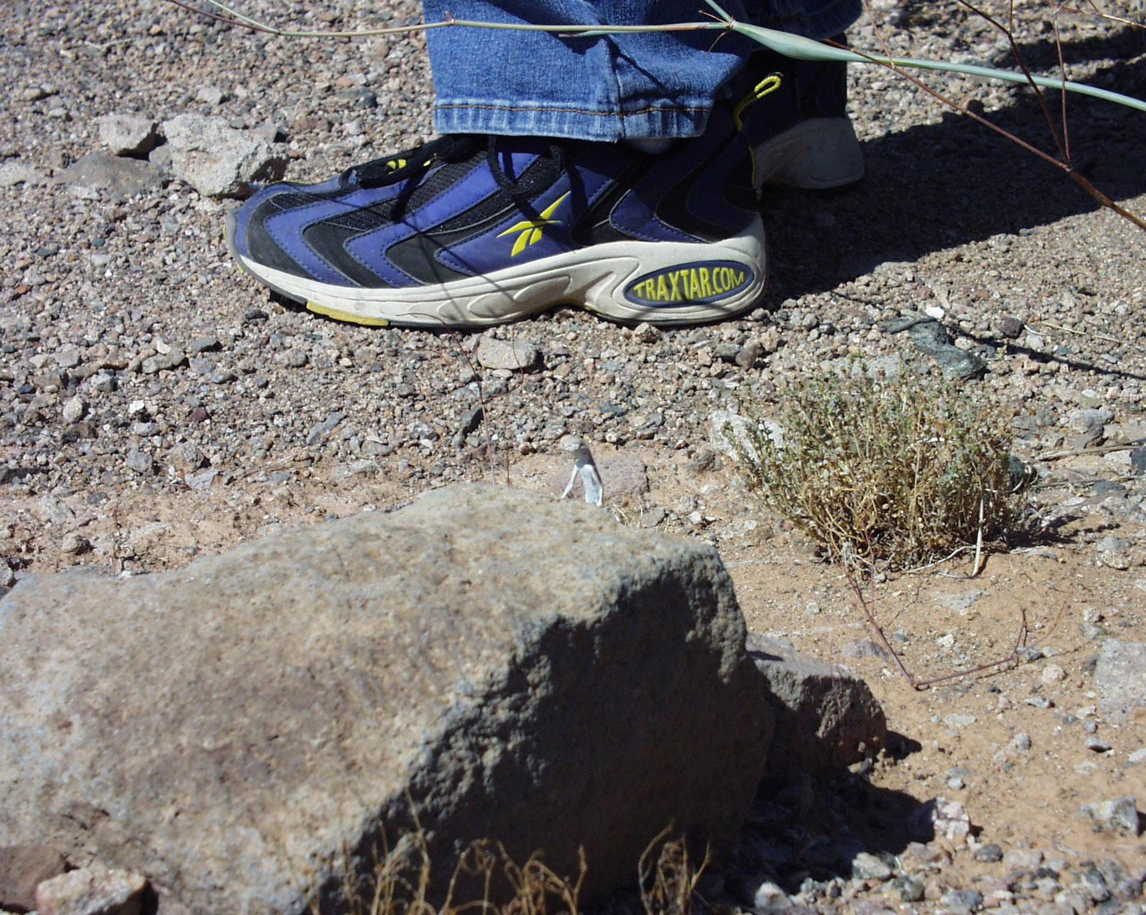
Be careful!
Notes:
Wear shoes for hiking on rough ground (no sandals)
There is no running allowed at any time during their field trip and that they are to stay on the trail unless we give them permission to explore the desert around the trail.

Slide 15
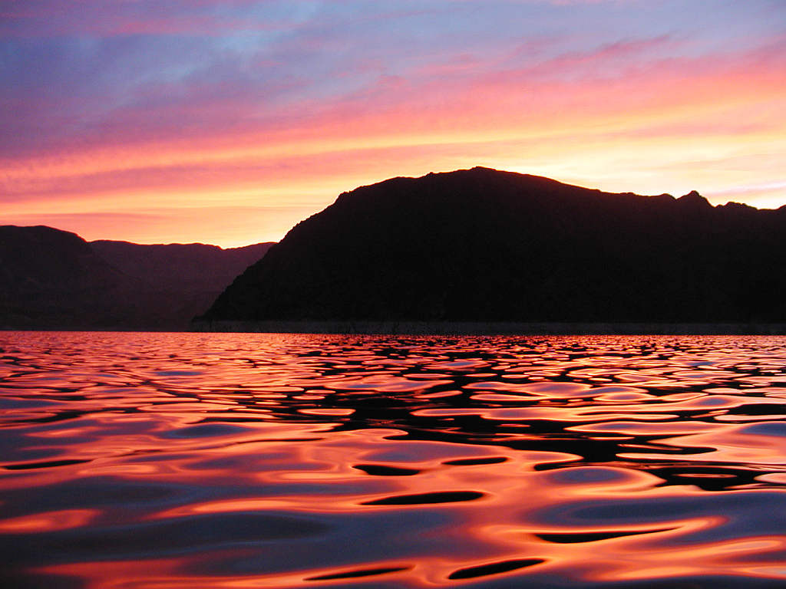
Leave No Trace
Notes:
Lake Mead NRA has many different plants, animals and rocks, and they are all necessary to the environment. We have 8-10 million visitors every year, and if everyone were to take home a lizard, a rock, or a wildflower, than we wouldn’t have anything left in a couple of years. Everything in the park is protected by law, and it is illegal to take anything from the park. Since they are proud owners of Lake Mead and other National Park sites, they have to take responsibility for helping us protect this area. We want them to be able to visit this area in the futures with their children and grandchildren and see the same park that they did, the first time that they saw it.

Slide 16

KNOW BEFORE YOU GO
CHOOSE THE RIGHT PATH
TRASH YOUR TRASH
LEAVE WHAT YOU FIND
BE CAREFUL WITH FIRE
RESPECT WILDLIFE
BE KIND TO OTHER VISITORS

Slide 17
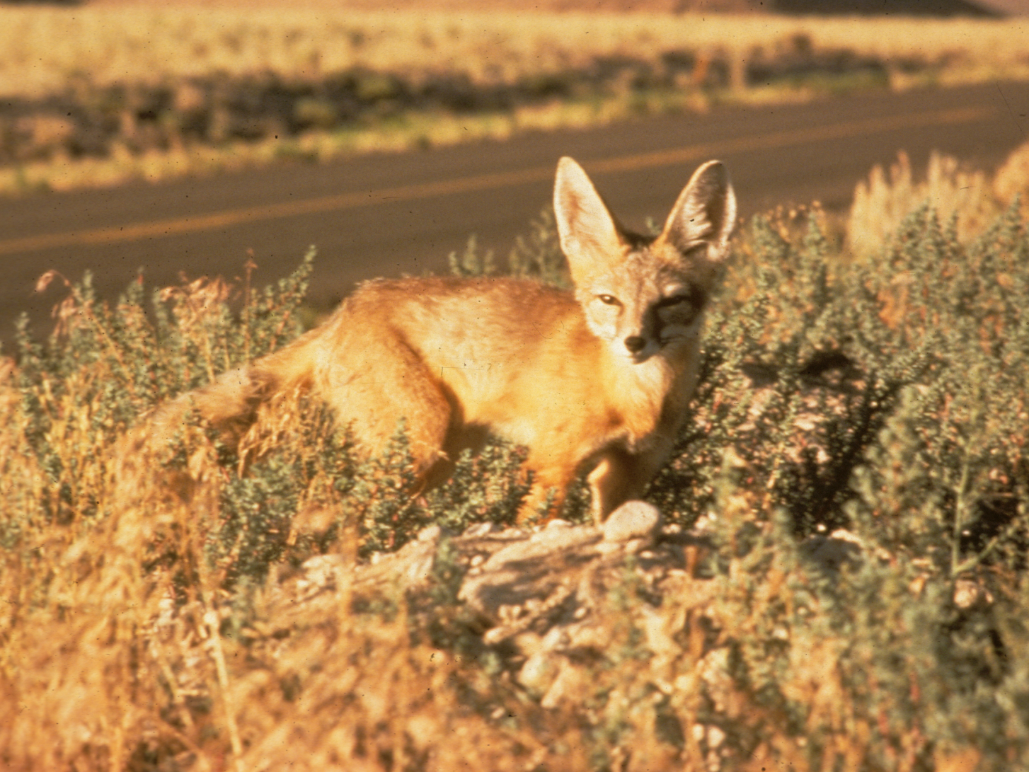
Notes:
For many 4th graders, there is a constant interest in the different wildlife that live within Lake Mead NRA and the Mojave Desert. There are numerous pictures that show the wide variety that call the desert home. Click through the pictures slowly and tell the students of the animal on the screen.

Slide 18
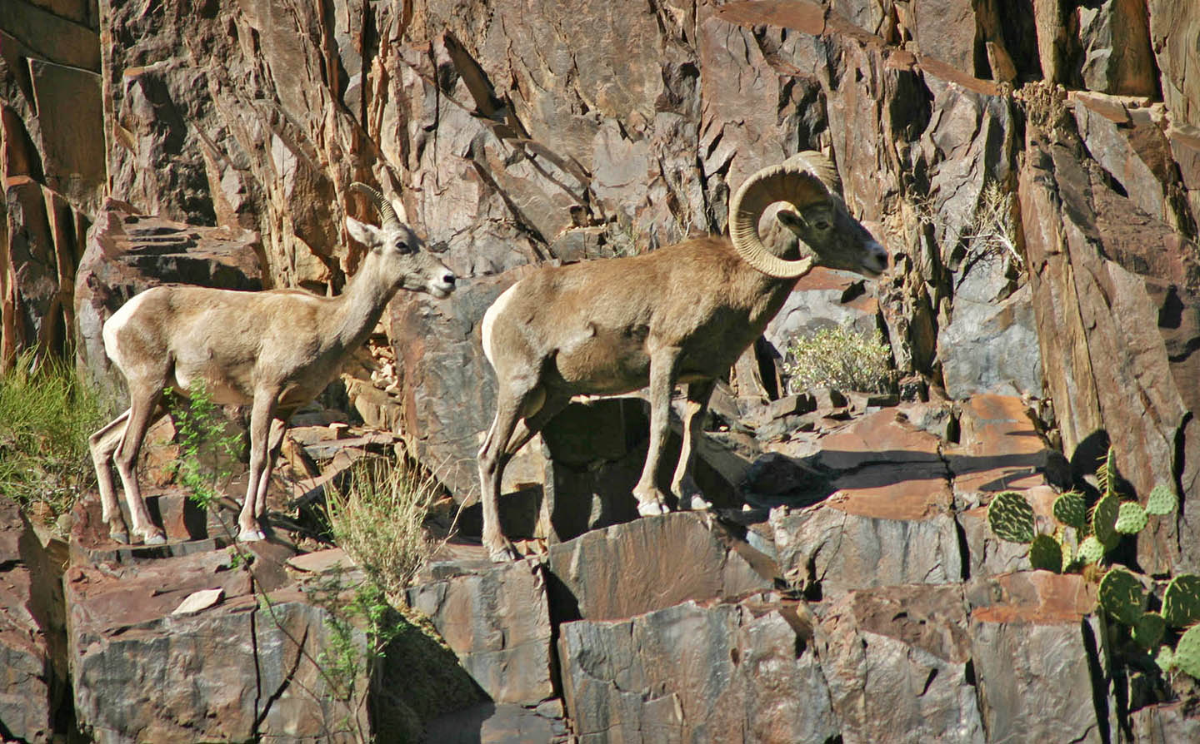

Slide 19
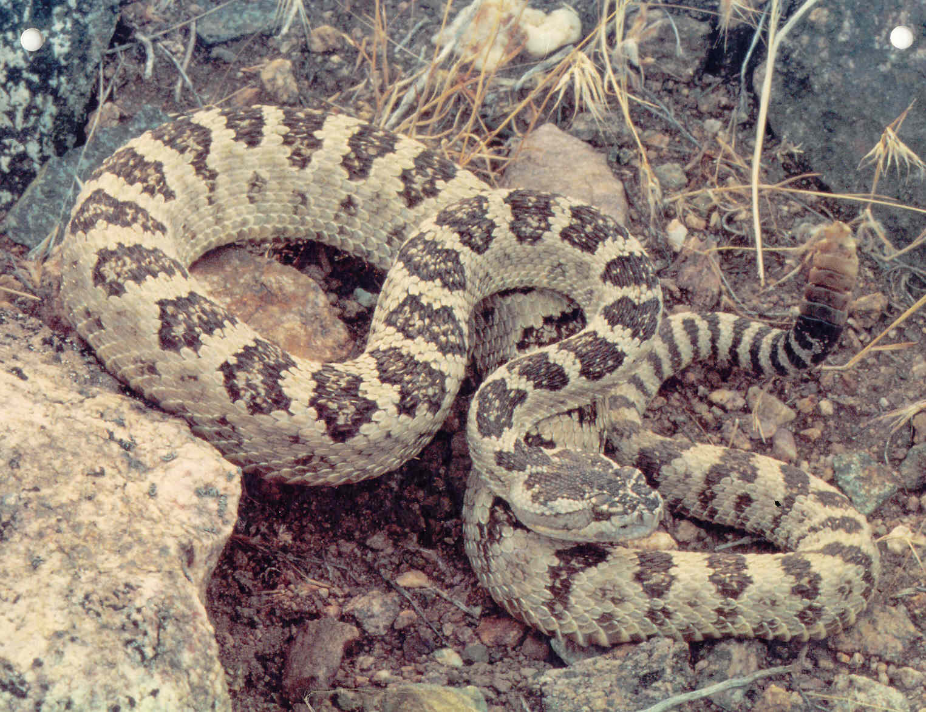

Slide 20
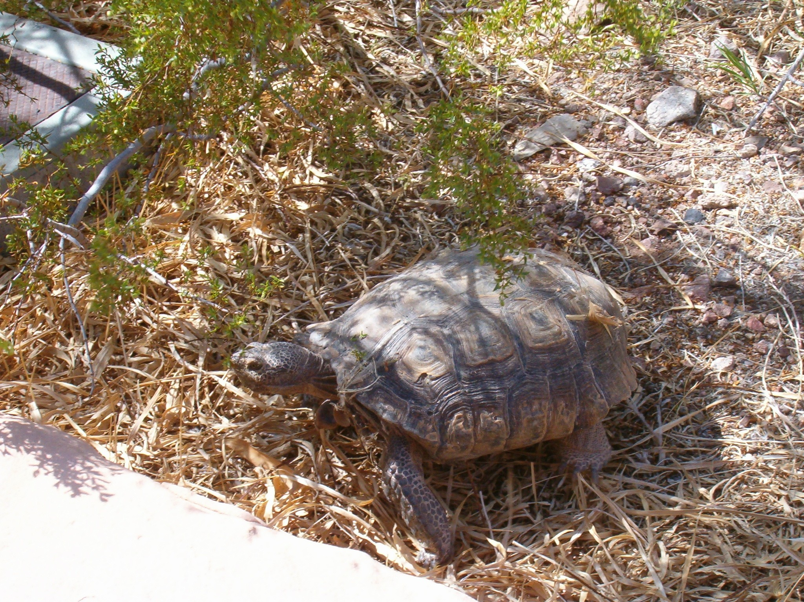

Slide 21
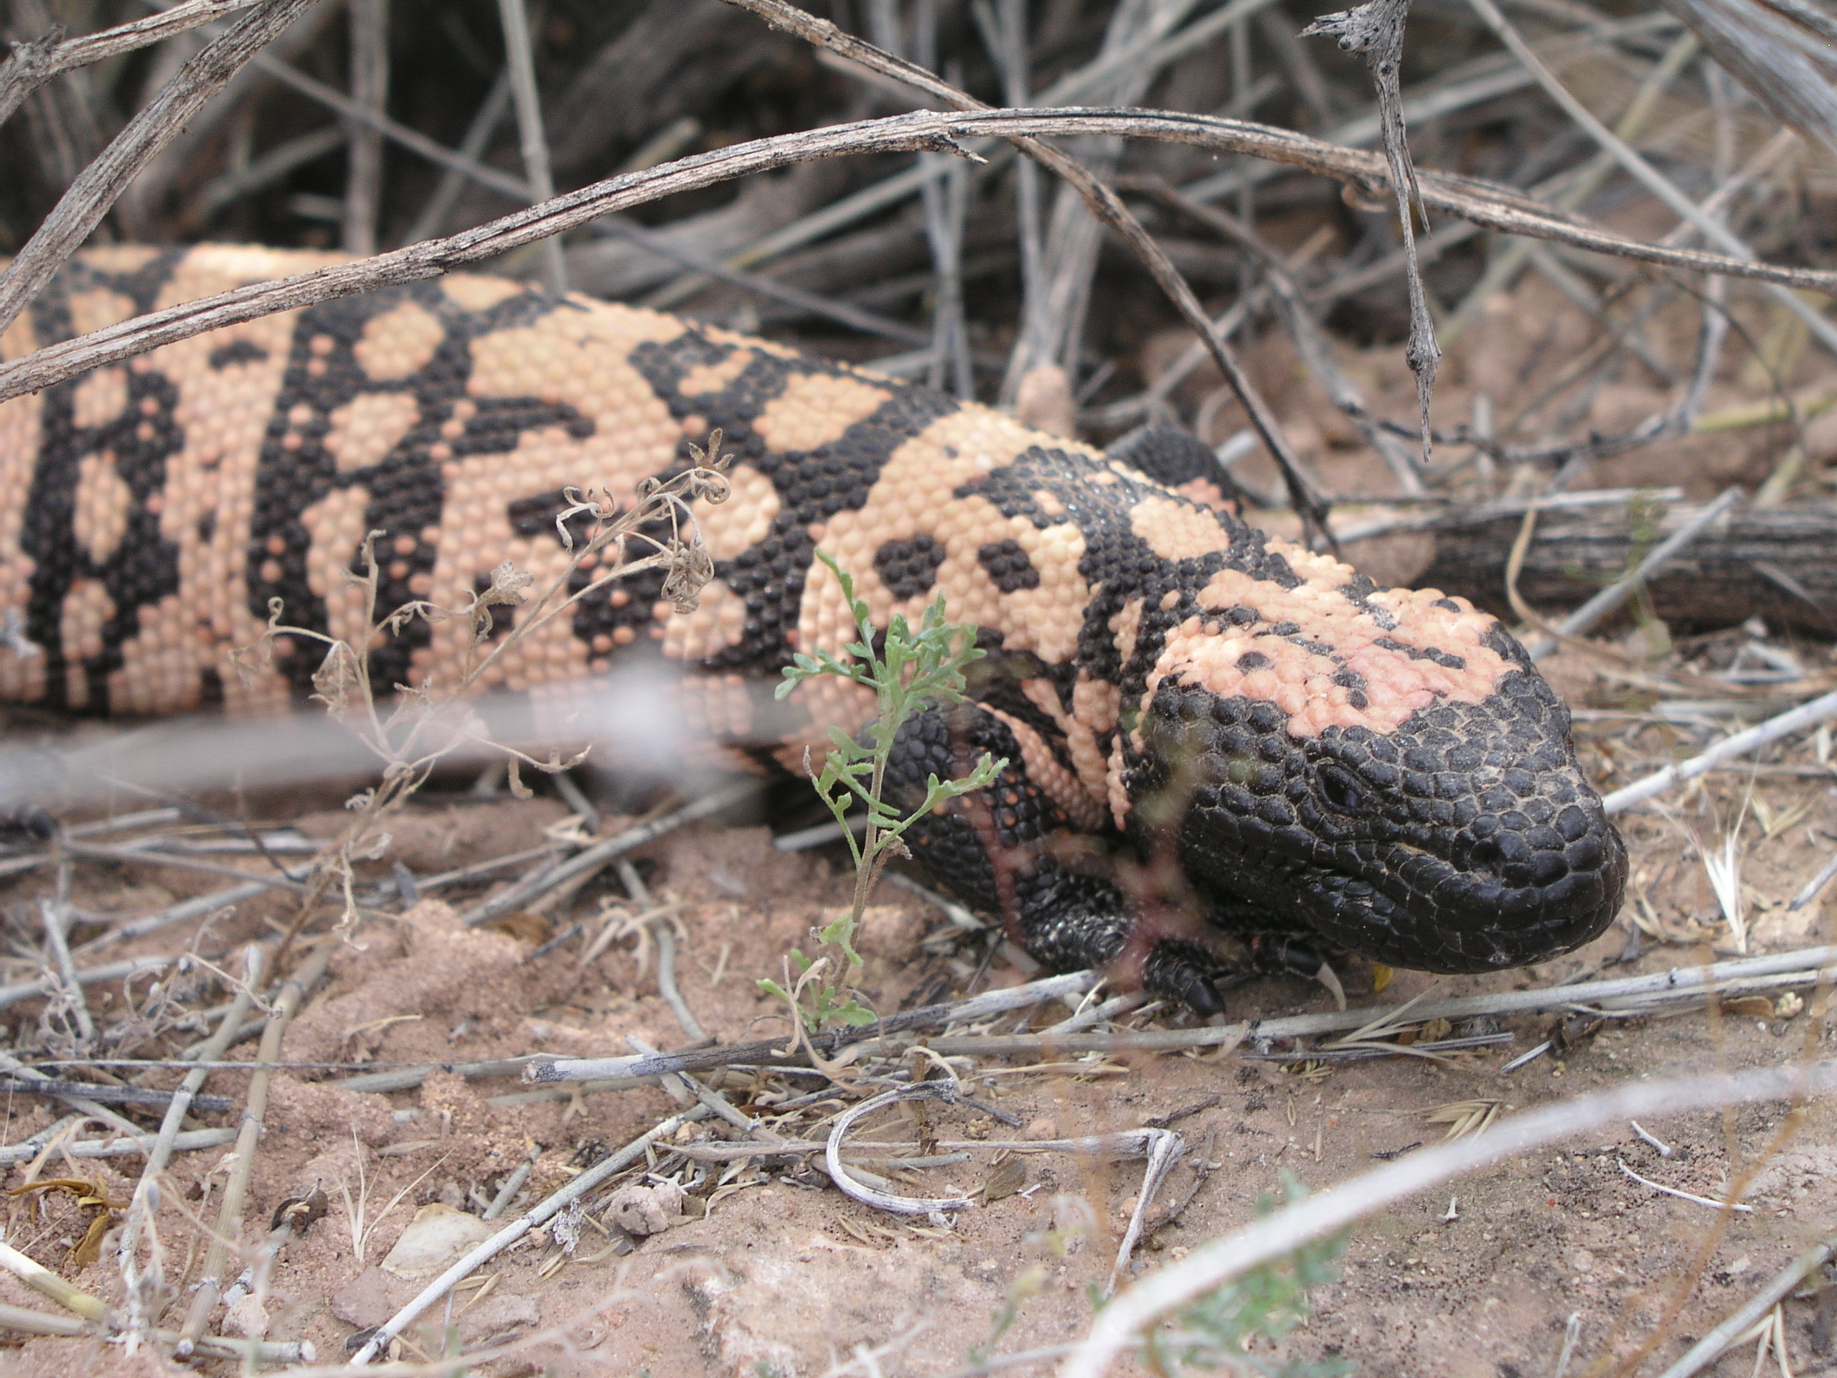
Notes:
Ask the students what they think they might see when they are on their fieldtrip. Let them know where they are going and what they will be visiting on their fieldtrip and what they are going to learn about. We expect them to give us their full attention on the filed trip, just like their teacher expects them to give him/her their attention in the classroom. Let them know that they are going to have fun, they are going to learn a lot, and they might get to see some animals. Remind them that even though they were many animals on the video, they might not get to see that many. When we shot that video, it was the perfect time of year and they might not see as many animals, but they will see lots of clues that animals live in the desert. This might lead into discussions of the fears that they might have about coming out for the field trip.

Slide 22
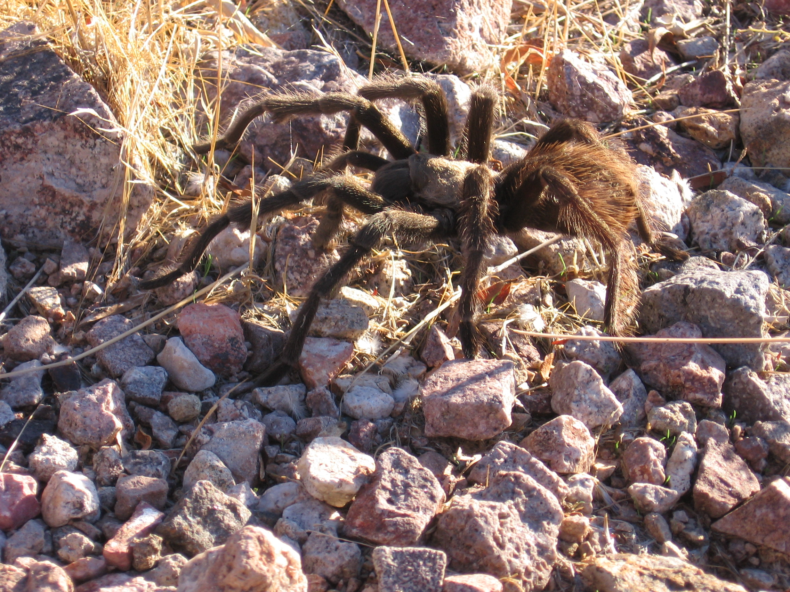

Slide 23
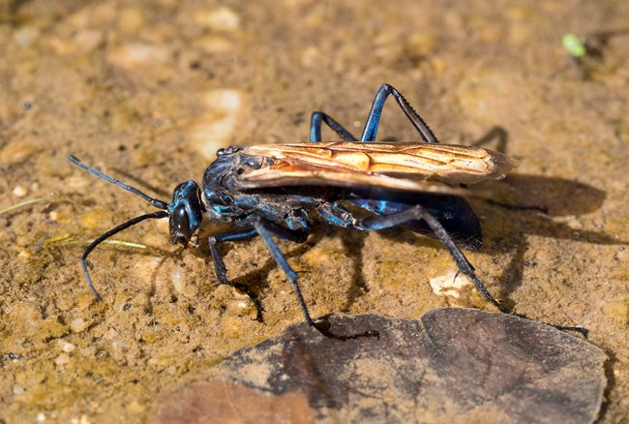

Slide 24
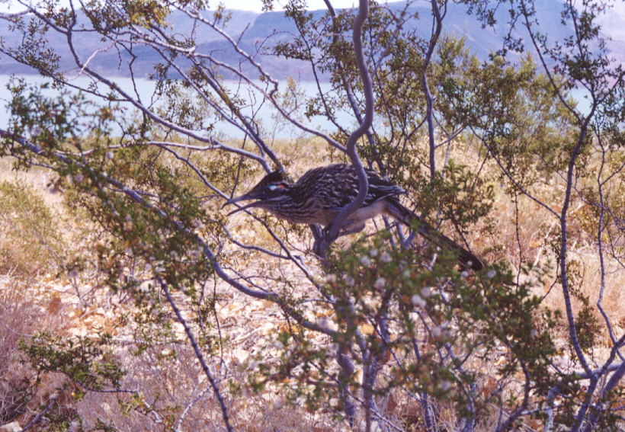

Slide 25
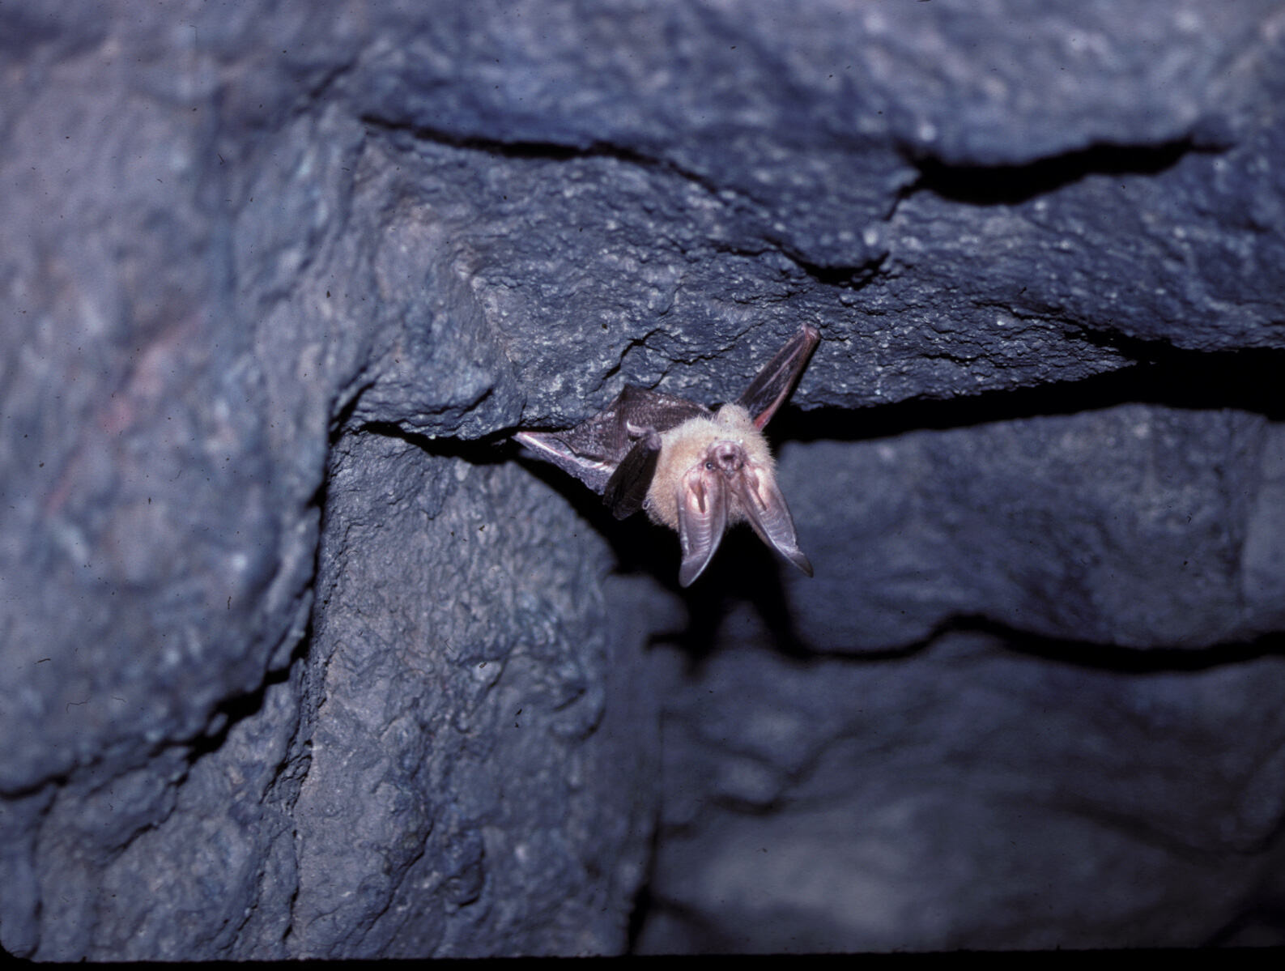

Slide 26
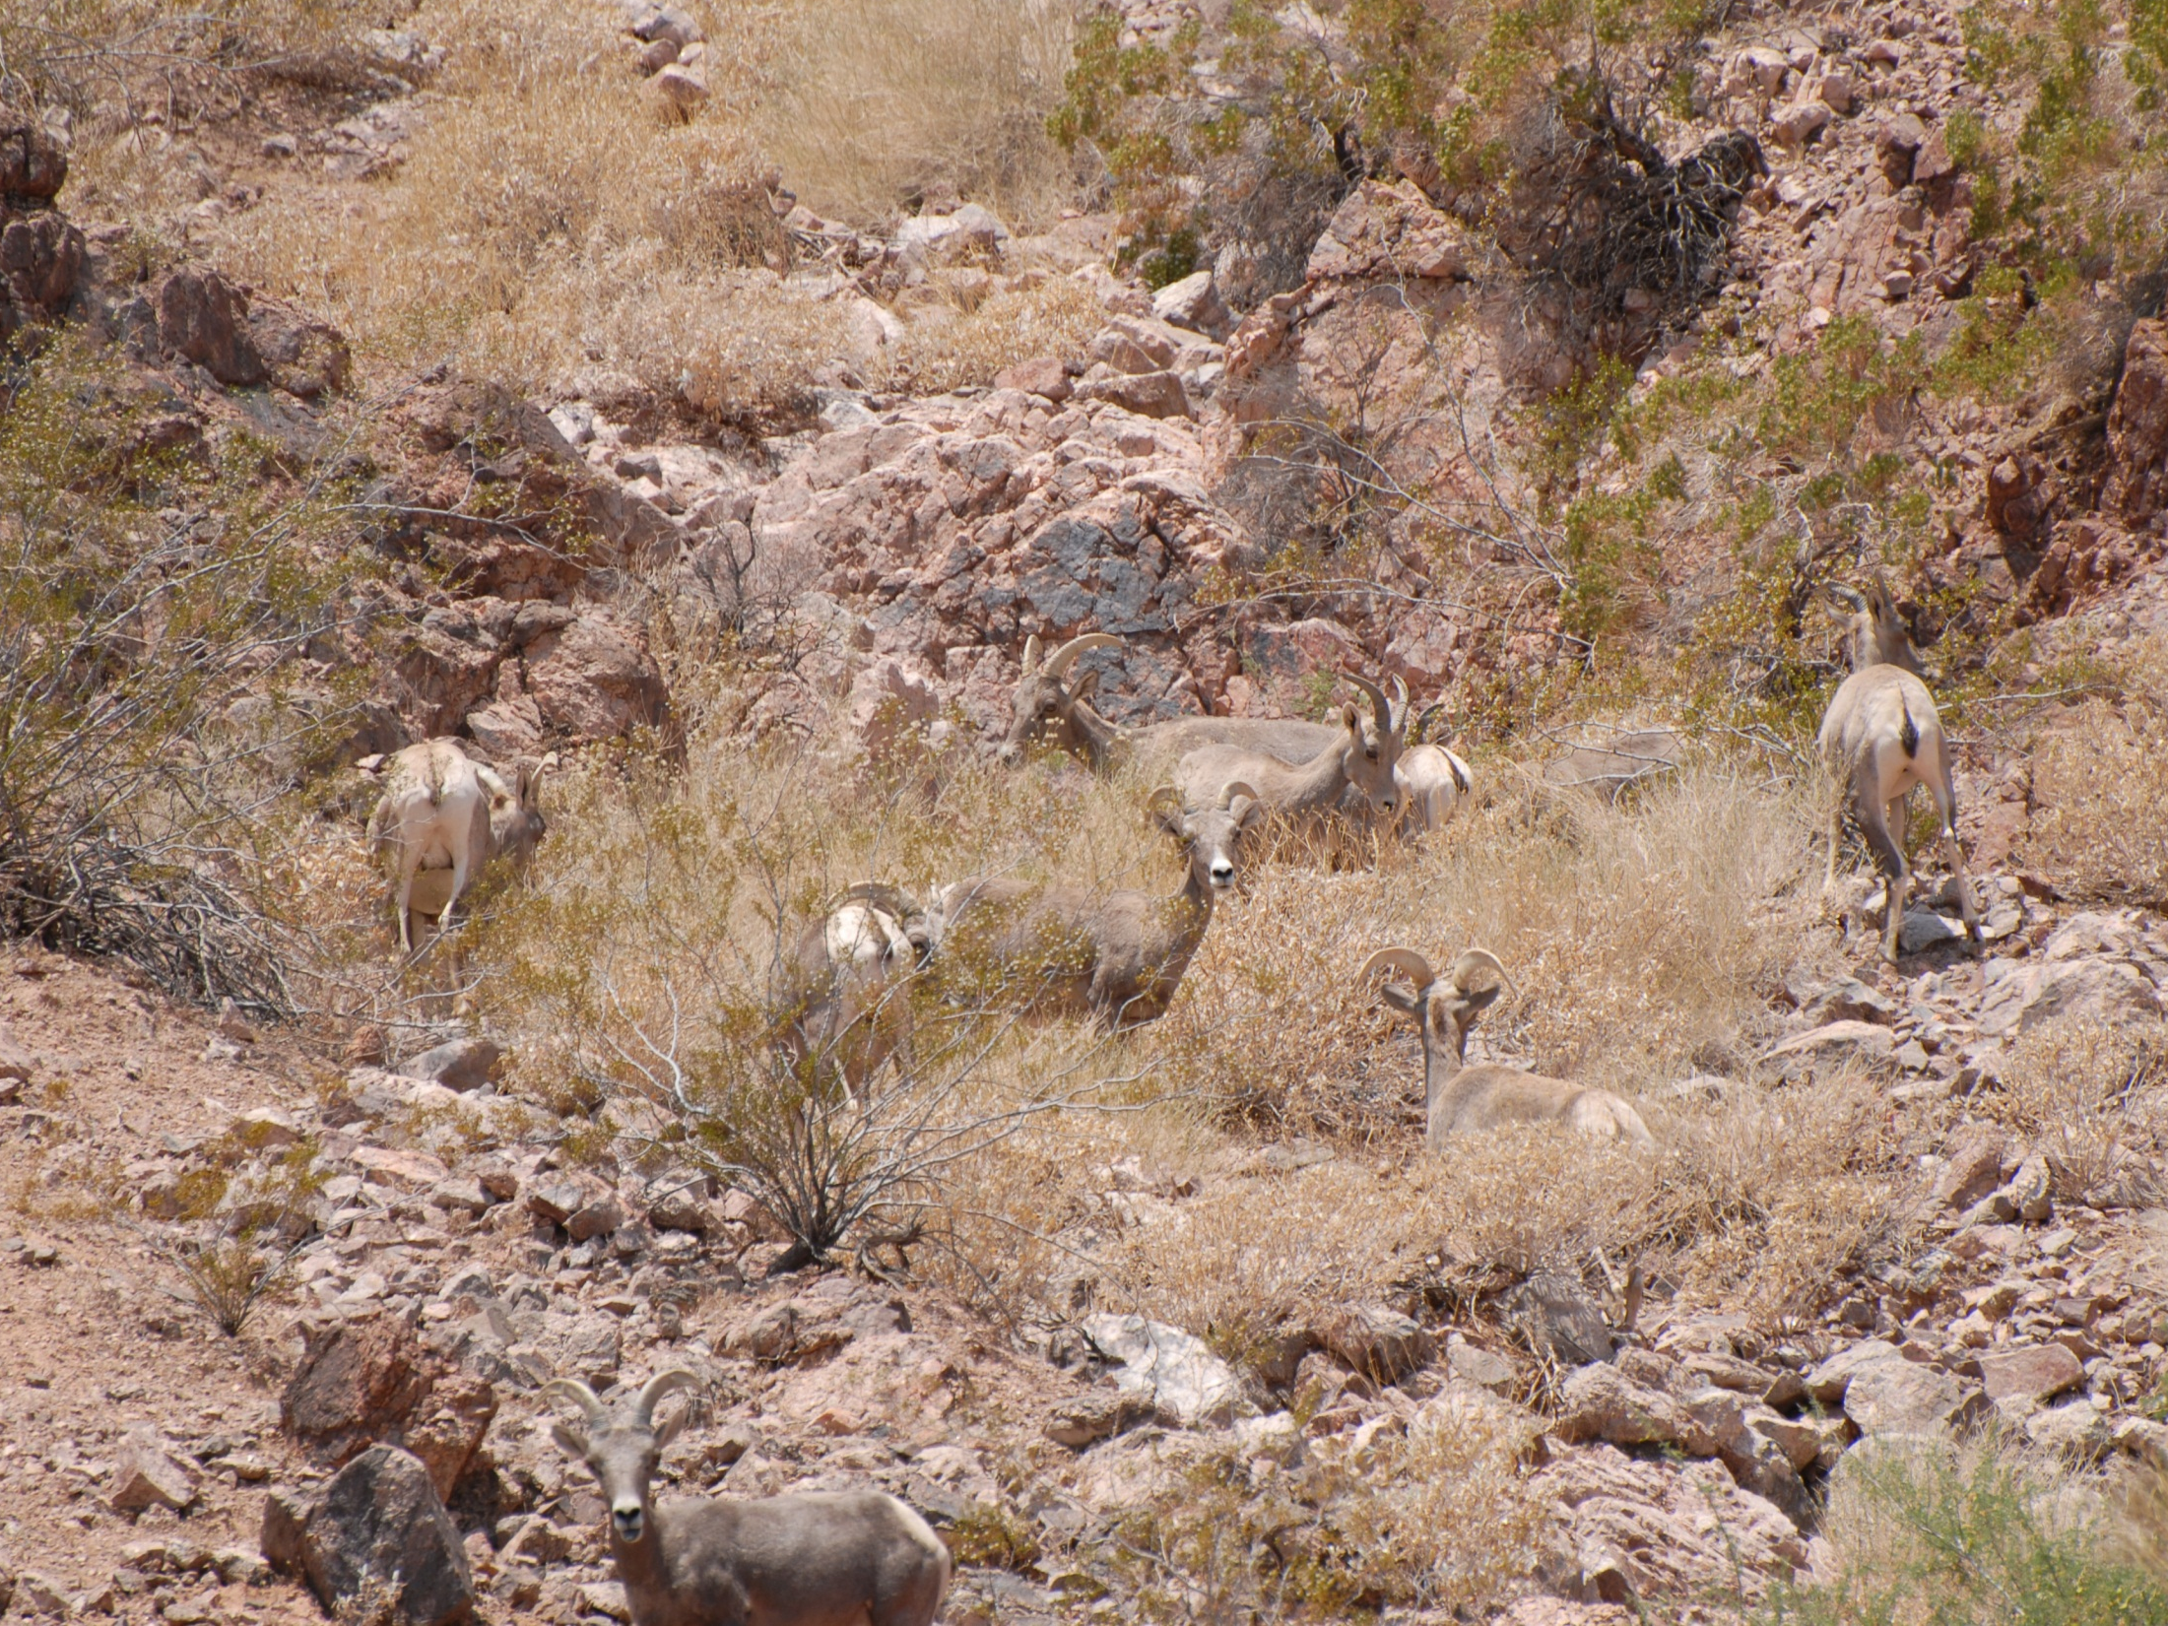
Notes:
One of the most well-known desert animals is the bighorn sheep. The bighorn sheep is a difficult animal to spot in the Mojave Desert, but with this page, ask the students to count as many bighorn as they can find in the image. Give the students 30 seconds to a minute and then ask the students (with a raise of hands) of how many they can see. After this, click through each number and have the group count together.

Slide 27
11
7
10
6
8
5
1
2
3
4
9

Slide 28
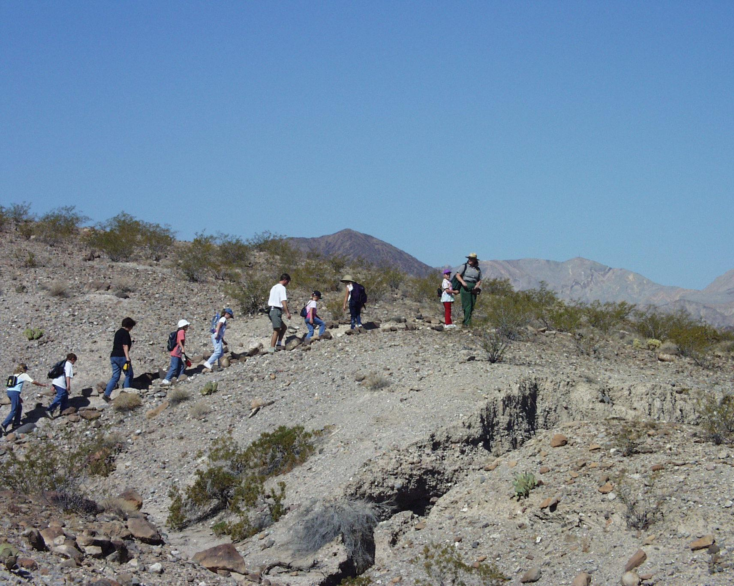
QUESTIONS?
Notes:
Give them time to ask you any questions that they might have.

Slide 29
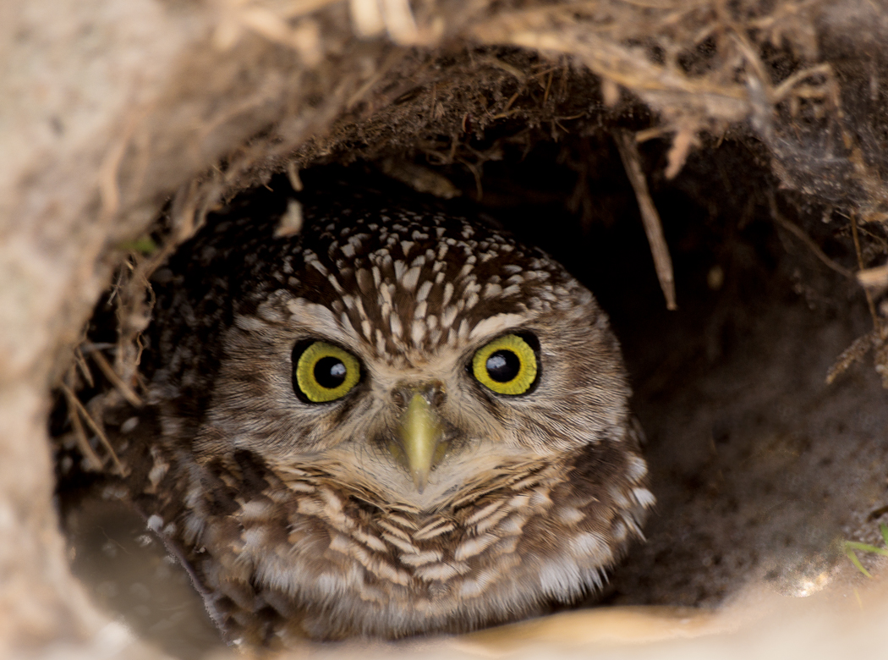
SEE YOU SOON!

